Slide 1
Exploring the Association between Information and Communication Technology and Quality of Life: An Empirical Study
Presented by Team Birst:
Abhidith Shetty, Tushal Kukreja, Anna Grace Nimmo, & Jeremy Montoya
BYGB-7975-001: Business Analytics for Managers
8th May 2023

Slide 2
Research Question
Is there an association between Information and Communications Technology and Quality of Life?
Rationale
The digital economy has rapidly grown in recent years, transforming how people communicate, work, and access information.
However, there is a lack of research on how this trend affects people’s quality of life.
Understanding the impact the digital economy has on quality of life is crucial for making informed decisions about technology and policy making.

Slide 3
Importance of Project
The study explores the relationship between Information and Communication Technology (ICT) and quality of life, providing insights into how ICT affects various aspects of well-being, including health, income, environment, education, and employment.
The research investigates the impact of the digital divide on social and economic development, shedding light on the potential negative effects of economic growth on environmental sustainability.
The study's findings have significant implications for policymakers, businesses, and individuals, as they seek to harness the potential of ICT to improve the well-being of people around the world.
The research contributes to the growing body of literature on the relationship between technology and society, providing new insights into the potential benefits and drawbacks of ICT.
The study is based on multiple years and countries, providing a broad perspective on the relationship between ICT and quality of life, which is beneficial for global policymakers.

Slide 4
Key Hypothesis and Variables
The presence of ICT enterprises positively affects socio-economic conditions in a country.
The digital divide negatively impacts social and economic development in countries.
Economic growth negatively impacts environmental sustainability.
The level of technological presence in a country positively impacts socio-economic factors.
Name | Definition | Scale | Type | Example | Independent/Dependent | Control
Broadband internet coverage (%) | Internet accessibility % | Ratio | Numeric | 60.2 | Independent | N
Employed Person with ICT Education | Tech-trained workers | Ratio | Numeric | 1,348.6 | Independent | N
Individual Internet Use (%) | Personal online activity | Ratio | Numeric | 78.59 | Independent | N
Mean income ($) | Average earnings amount | Ratio | Numeric | 21,483 | Dependent | N
Environmental Problems (Crime and Pollution) (%) | Eco-crime rate | Ratio | Numeric | 10.7 | Dependent | N

Slide 5
Data Description
Data Source: EuroStat https://ec.europa.eu/eurostat/web/main/data/database
Time/Years: 2013 - 2019
Study Type: Cross-sectional
Data Size: No. of years * No. of rows * No. of variables = 7 * 210 * 18 = 26, 460
Included Real GDP growth rate (%) and Mean median income in our analysis due to a large number of missing values in the other variables, and also acknowledged the potential presence of multicollinearity between these two variables.

Slide 6
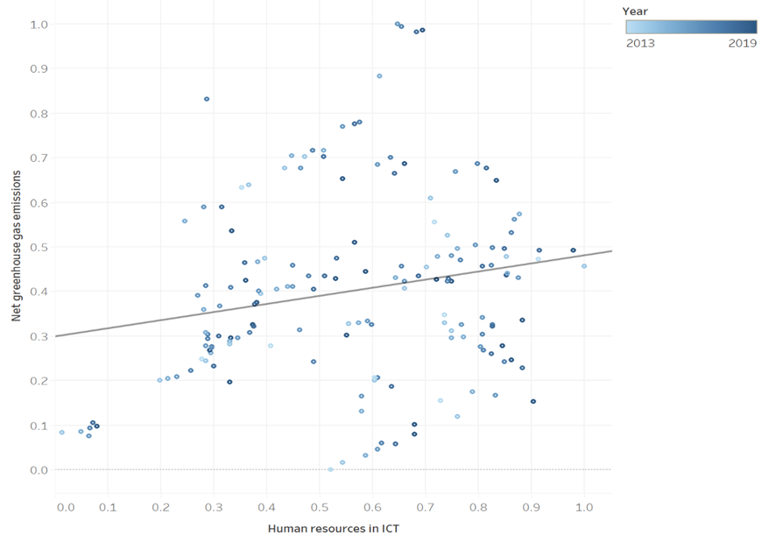
Economic growth negatively impacts environmental sustainability
The scatter plot shows the relationship between Human Resources in information and communication technology and Net green gas emission.
The insight from the analysis is that there is a positive relationship between Human Resources in information and communication technology (%) and Net green gas emissions (%). The R-square is 0.039.
The implication of the analysis is that contrary to the hypothesis that economic growth negatively impacts environmental sustainability, this study suggests that the use of ICT may have a positive impact on greenhouse gas emissions.
Trend Line:
Equation: Net greenhouse gas emissions (%) = 0.181815*Human resources in ICT (%) + 0.298677
Net greenhouse gas emissions (%) = 0.181815*Human resources in ICT (%) + 0.298677

Slide 7
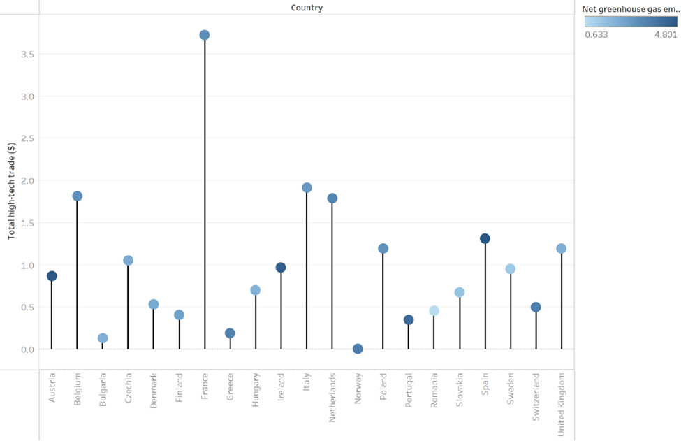
Economic growth negatively impacts environmental sustainability
The lollipop chart compares the Net greenhouse gas emissions (%) and Total high-tech trade ($) for 20 different countries.
The data suggests that there is no clear correlation between the two variables. However, there are some outliers, such as Austria and Ireland, that have relatively high greenhouse gas emissions despite low levels of high-tech trade.
The control variable of net national income (%) may be a factor in the relationship between high-tech trade and greenhouse gas emissions. Countries with higher net national income may have more resources to invest in green technology and infrastructure, which could lead to lower emissions despite higher levels of high-tech trade.

Slide 8
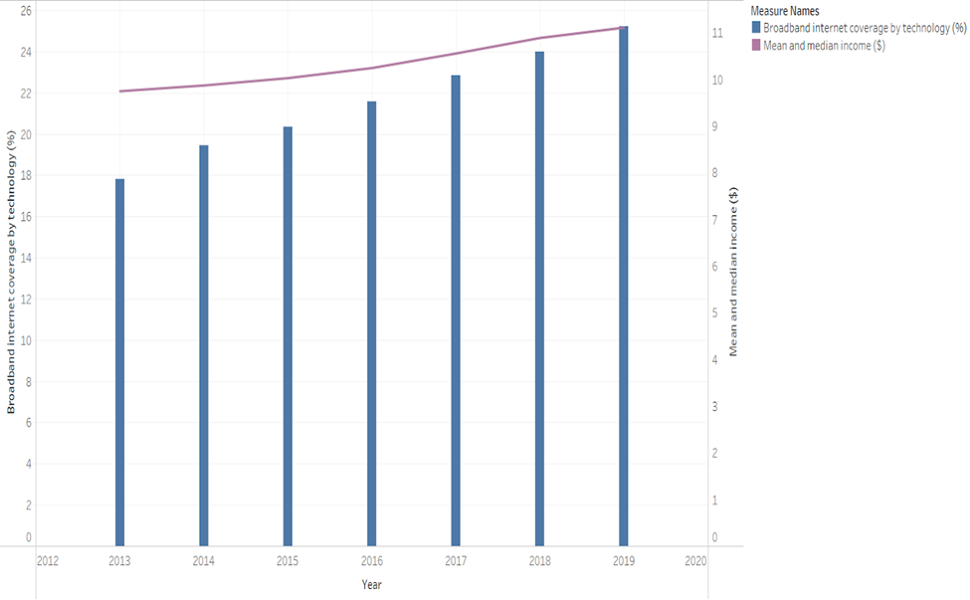
Trend of Broadband Internet Coverage (%) and Income for years 2013 - 19
The dual combination (Bar/Line) chart shows the trend of broadband internet coverage (%) and mean/median income, from 2013 to 2019.
The insight from this chart is that there is a positive relationship between broadband internet coverage and income. Regions with higher income tend to have higher broadband internet coverage and vice versa.
The implication of this insight is that access to broadband internet may be a contributing factor to income inequality. Regions with lower broadband internet coverage may have limited access to information, education, and job opportunities available online, which could perpetuate a cycle of low income. Improving broadband internet coverage in these areas could potentially help to reduce income inequality.

Slide 9
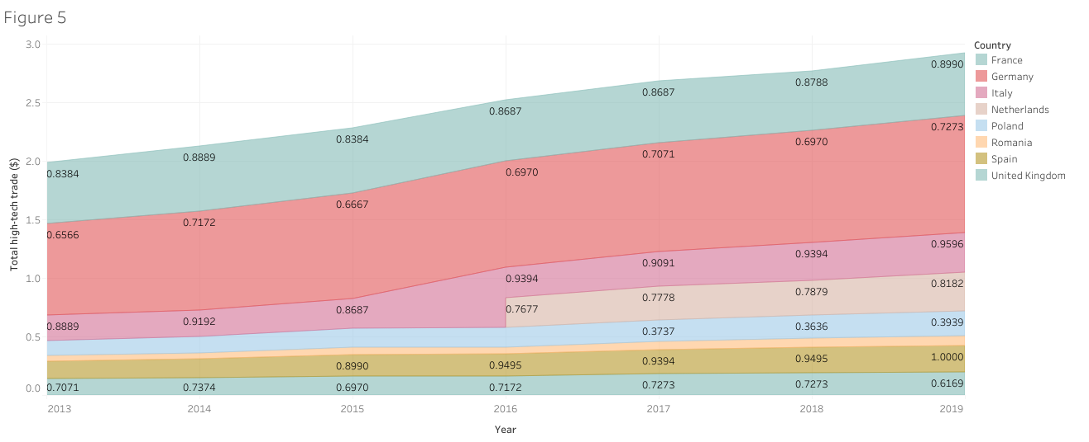
Total high-tech trade ($) by life expectancy (%) filtered by population
● The area chart shows years on the x axis and total high-tech trade on the y, the countries are represented by the different colors and the numbers in the chart represent the percentage of life expectancy.
● The threshold for the filter was at least an average percentage of 0.2 which Netherlands only started to meet in 2016. The trend seems to be that as total high-tech trade increases so does the life expectancy for a country.
● A recommendation would be to continue to encourage high-tech trade as the life expectancy is increasing as well

Slide 10
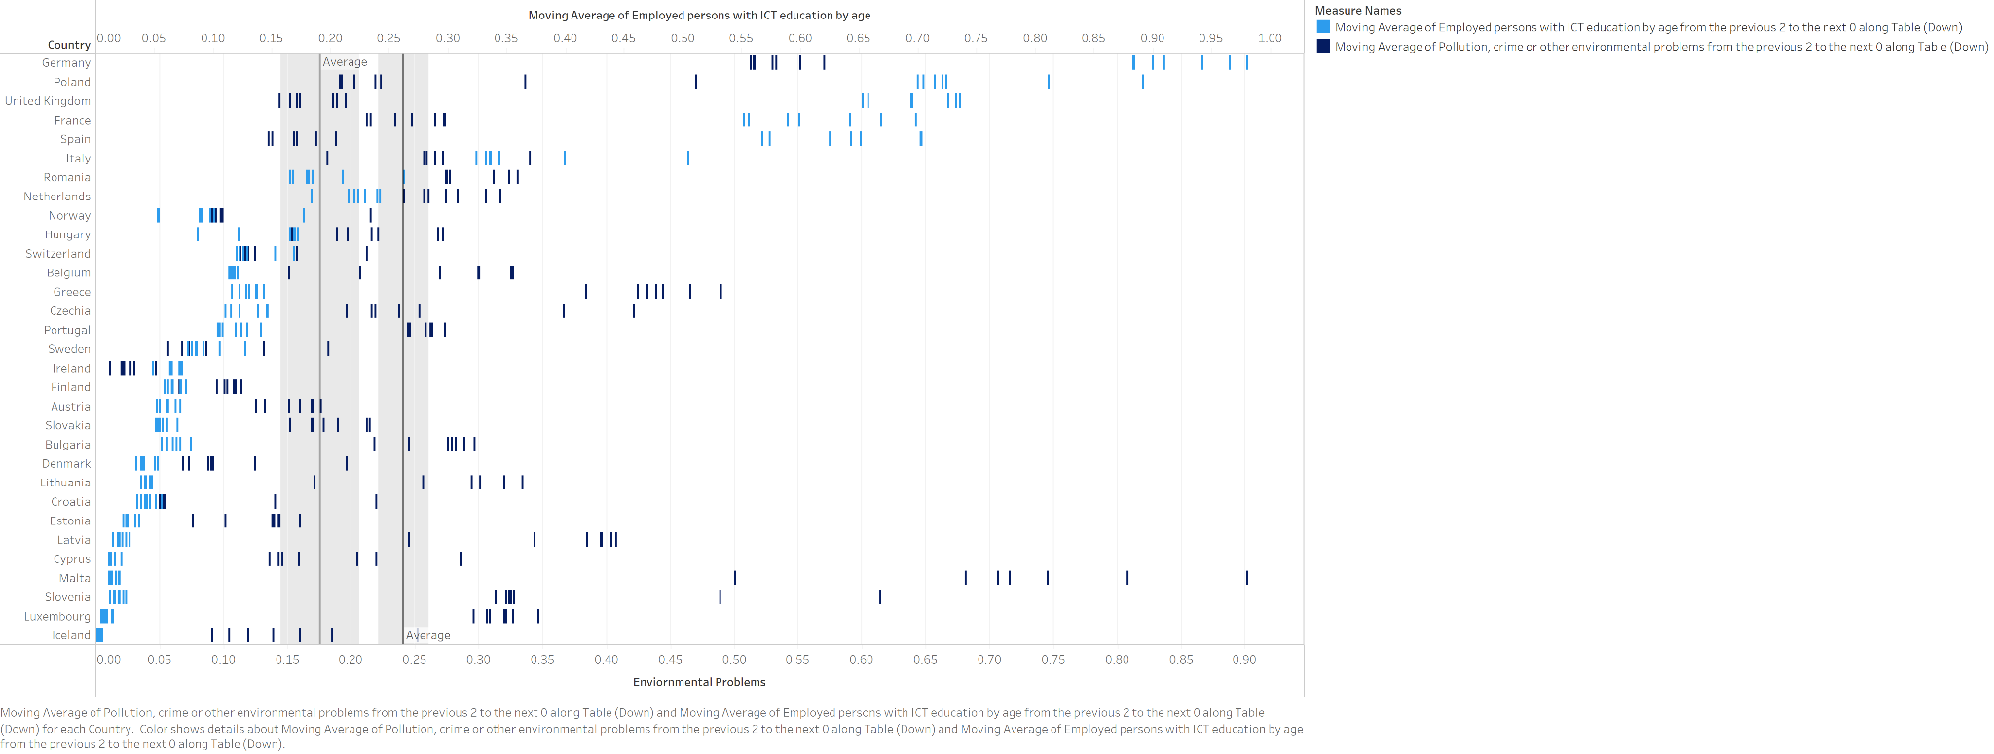
Moving Averages of Persons with ICT Education and Environmental Problems, Controlled by Country
This chart presents the following findings, at first before applying calculation Employed Persons with ICT education have an average of .187 while environmental problems have a median of .261; to dive further to see if there would be a significant effect in adding moving averages calculation.
After applying the calculation, the ECT education has an average of .1910 while environmental problems have an average of .2411. The observation shows that there is slowing of environmental problems when ICT education is increased however this rate of slowing was .00331667 a year over the 6 years of data collection.

Slide 11
Conclusions
Contrary to the hypothesis that economic growth negatively impacts environmental sustainability, this study suggests that the use of ICT may have a positive impact on greenhouse gas emissions.
There is no clear correlation between Net greenhouse gas emissions (%) and Total high-tech trade ($).
There is a relationship between broadband internet coverage and income. Regions with higher income tend to have higher broadband internet coverage and vice versa.
As total high-tech trade increases, so does the life expectancy for a country. Encouraging high-tech trade may lead to an increase in life expectancy.

Slide 12
Scope & Limitations
The project aims to explore the relationship between ICT and quality of life variables in multiple countries and years.
The project findings could have important implications for policymakers, businesses, and individuals seeking to harness the potential of ICT to improve quality of life.
The project may face challenges in comparing data across different countries and years, due to differences in data collection and measurement.
The project is limited to the variables included in the dataset and may not capture all relevant factors affecting quality of life.
The project is limited to correlational analysis and cannot establish causation between ICT and quality of life variables.

Slide 13
Managerial Implications and Recommendations
Governments and businesses should prioritize investment in ICT infrastructure, such as broadband internet and ICT education, to promote economic growth and social development.
Efforts should be made to reduce the digital divide and ensure equitable access to ICT resources, particularly for marginalized populations, to promote equal opportunities and social inclusion.
Policies and programs should be implemented to promote sustainable economic growth and development, while also addressing environmental concerns and reducing greenhouse gas emissions.
Public spaces and urban areas should prioritize the provision of public WiFi to promote community connectivity and reduce social isolation.
Educational and financial institutions should promote the use of online resources and e-banking to improve financial literacy and economic security.

